Slide 1
Research Report
Vo Khoi Thanh Son
19-4-2024

Slide 2
Setting up file task
- Creating environment for training a 3-fingered gripper with 5 joints per fingers based on Isaac Gym's RL framework
- Implement sim setup, initialize state, action
- Create config files for task and training
- Using PPO algorithm from IsaacGymEnvs Benchmarks to train the policy

Slide 3
Environment setup
- 2 ways of controlling the gripper motion:
Position control (DOF_MODE_POS)
Apply force
(DOF_MODE_EFFORT)
Apply position targets for moving the gripper’s base
Use position control or apply force to the joints of fingers for gripping the object
+ Num of obs: 32 --> sphere_pose (7) + eef_pose (7) + q_gripper (18)
+ Num of actions: 4 --> translation of base (3) + gripping bool (1)

Slide 4
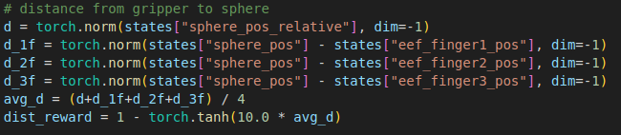
Reward shaping
$$r_{t} = ω_{dist} \left(r_{dist}\right) + ω_{lift} (r_{lift})$$
Distance reward
+ d: distance between gripper base and sphere
+ d_1f, d_2f, d_3f is distance between the sphere and each of the three fingers of the gripper

Slide 5
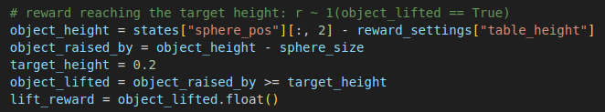
Reward shaping
Lift reward
+ Reward for shere reaching target_height

Slide 6
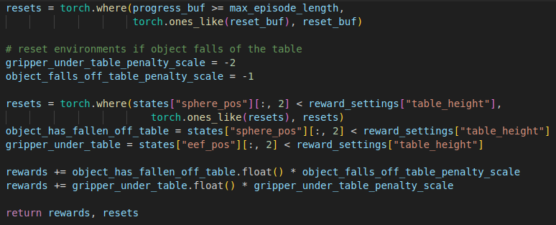
Reward shaping
Determining resets
+ Reset when reaching max episode length or if the object falls off the table
+ Penalty for object falling out and gripper searching under the table

Slide 7
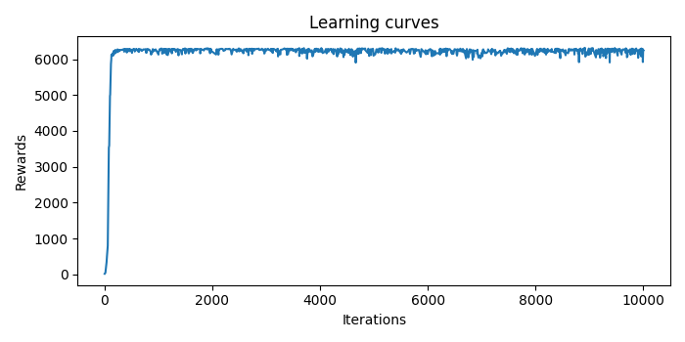
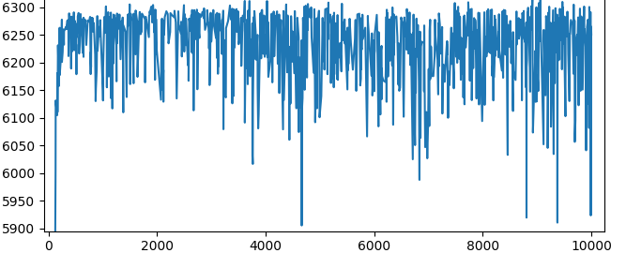
Training results
Learning curve after 10000 iterations of training

Slide 8
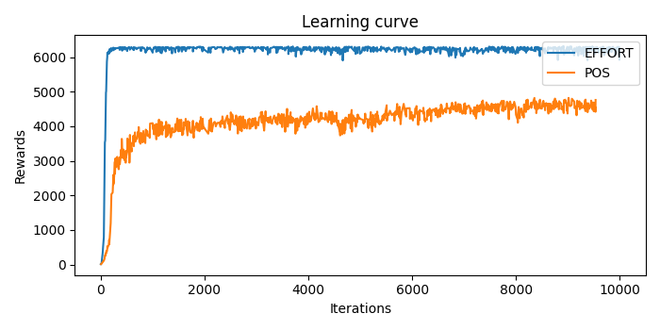
Training results
Comparison between position and force control
Force: the fingers can quickly grasp the object
Pos: the fingers have difficulties holding the object

Slide 9
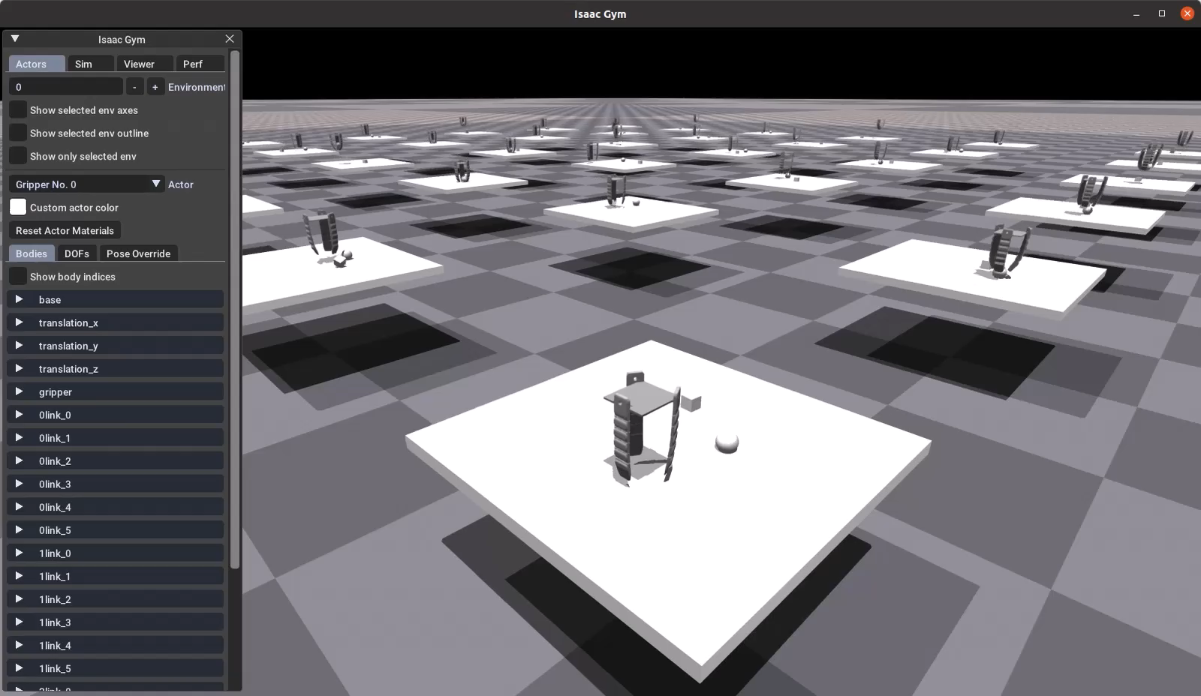
Training results
Simulation of 3-fingered gripper grasping the object

Slide 10
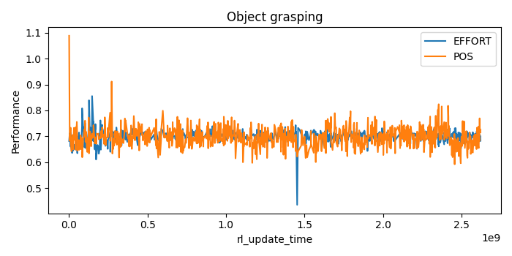
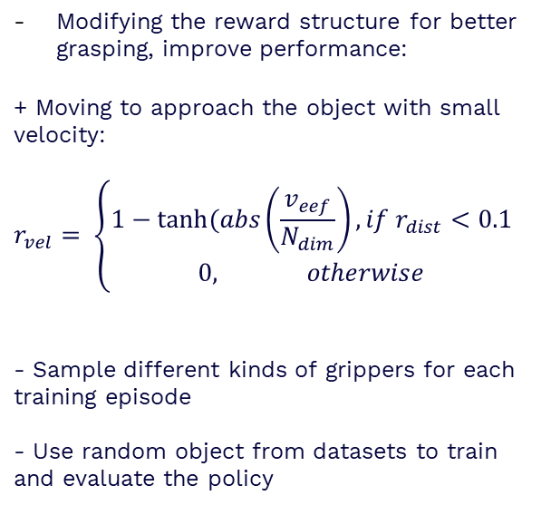
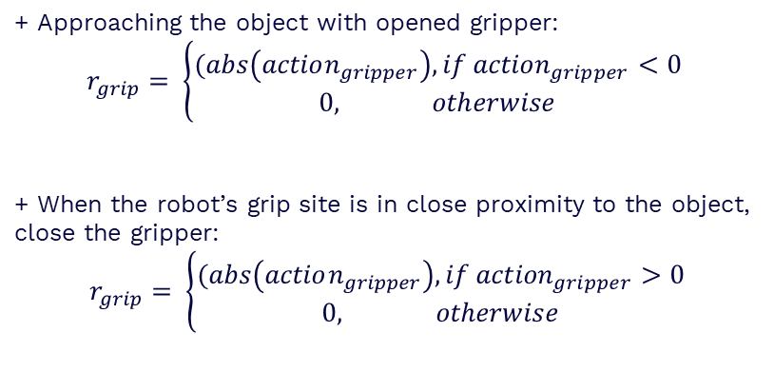
Future work
+ Approaching the object with opened gripper:
$$r_{grip}= \left\{\begin{aligned}⁡(abs\left(action_{gripper}\right), if {action}_{gripper}<0 \\ 0, otherwise\end{aligned}\right.$$
+ When the robot’s grip site is in close proximity to the object, close the gripper:
$$r_{grip}= \left\{\begin{aligned}⁡(abs\left(action_{gripper}\right), if {action}_{gripper}>0 \\ 0, otherwise\end{aligned}\right.$$
Modifying the reward structure for better grasping, improve performance:
+ Moving to approach the object with small velocity:
$$r_{vel}= \left\{\begin{aligned}1−tanh⁡(abs\left(\frac{v_{eef}}{N_{dim}}\right), if r_{dist}<0.1 \\ 0, otherwise\end{aligned}\right.$$
- Sample different kinds of grippers for each training episode
- Use random object from datasets to train and evaluate the policy

Slide 11
Thanks!

